Slide 1
Major Global Digital Policy Frameworks in Cybersecurity
Name – Rudraksh Mehra
Roll no - CS-2341243
Class - 2CSE5
Dept. - Btech- CSE

Slide 2
Introduction
Purpose of the Study : To analyze cybersecurity effectiveness across countries using various indices (GCI, CEI, NSCI).
To explore the relationship between digital development and cybersecurity readiness.

Slide 3
Dataset Overview
Dataset Description:
Country: The name of the country being analyzed.
Region: The geographical region (e.g., North America, Europe).
CEI (Cybersecurity Effectiveness Index): A score indicating the effectiveness of a country's cybersecurity policies.
GCI (Global Cybersecurity Index): An index ranking countries based on their cybersecurity measures across various dimensions.
NSCI (National Cybersecurity Index): Measures a country's preparedness to protect its digital infrastructure.
DDL (Digital Development Level): Represents the overall digital maturity and technological adoption of a country.
Source: This dataset is sourced from Kaggle

Slide 4
Cybersecurity Readiness Across Countries
Description: A filled map visualization that displays the Cybersecurity Effectiveness Index (CEI) for each country.
Insights:
Countries like Afghanistan , Myanmar have the highest scores, indicating strong cybersecurity policies and infrastructure.
Countries like India, Singapore need improvement in their cybersecurity measures.
Countries like Australia , Canada are lagging in cybersecurity readiness.

Slide 5
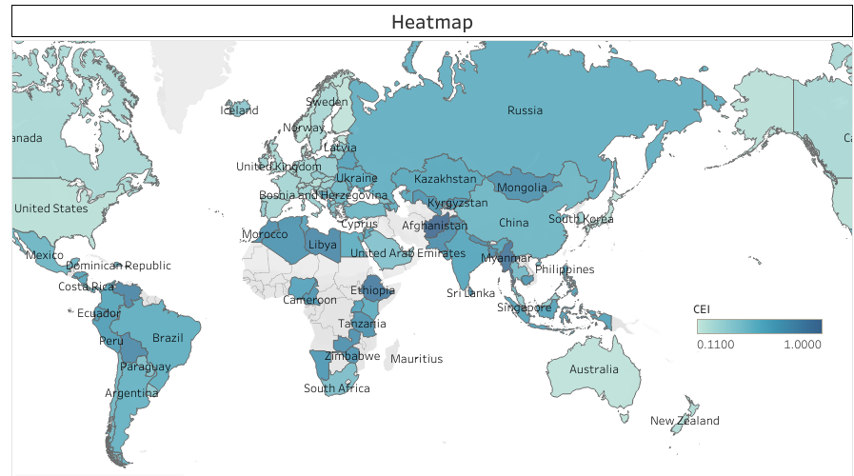

Slide 6
Comparison of Cybersecurity Indices
Description: A bar chart that compares the three key cybersecurity indices—GCI, CEI, and NSCI—for selected countries.
Insights:
Comparative Rankings: The bar chart reveals that countries like Afghanistan, Myanmar, and Ethiopia have high CEI scores, indicating effective policies despite broader challenges.
Discrepancies: In contrast, nations with GCI scores, such as the US, UK, and Saudi Arabia, showcase strong legal and technical frameworks but may not reflect operational effectiveness as seen in CEI.
Top Performers: Countries with high NSCI scores include Greece, Belgium, and Lithuania, highlighting their preparedness and resilience in protecting digital infrastructure.
Implications: These disparities suggest that effective cybersecurity is multifaceted, and investments in policy, technology, and operational capacity must align to enhance overall cybersecurity effectiveness globally.

Slide 7
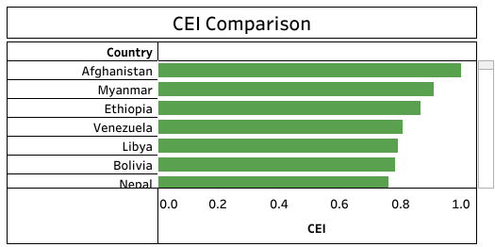
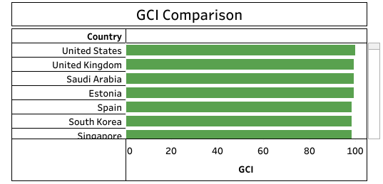

Slide 8
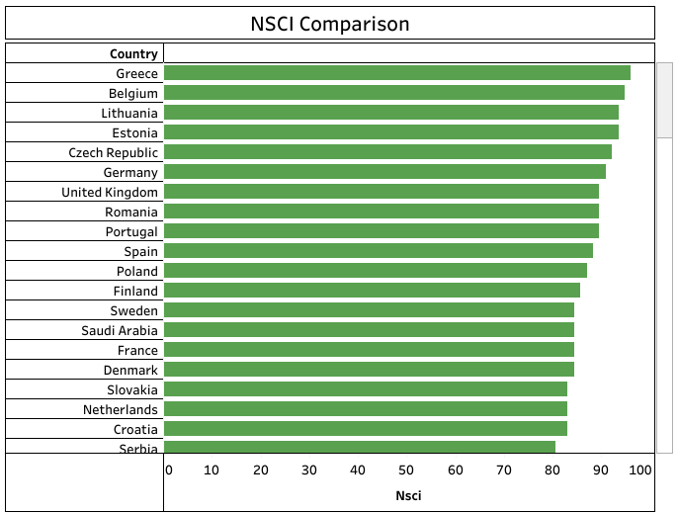

Slide 9
Cybersecurity Effectiveness vs. Digital Development
Description: A scatter plot displaying the relationship between the Cybersecurity Effectiveness Index (CEI) and the Digital Development Level (DDL) for each country.
Insights:
Relationship Exploration: The scatter plot illustrates a general trend where countries with higher DDL tend to have more effective cybersecurity measures (CEI).
Outlier Identification: Notable outliers include Mauritius, Belgium, and Denmark, which exhibit low CEI scores despite high DDL. This discrepancy suggests that high digital maturity does not always equate to effective cybersecurity practices, prompting further investigation into the factors at play.
Policy Implications: Countries with high DDL should focus on strengthening their cybersecurity measures to ensure that their technological advancements are secure.
Strategic Focus: Encourage policymakers to recognize the importance of aligning digital development with robust cybersecurity strategies, emphasizing that technological advancement must be accompanied by effective security policies and practices.

Slide 10
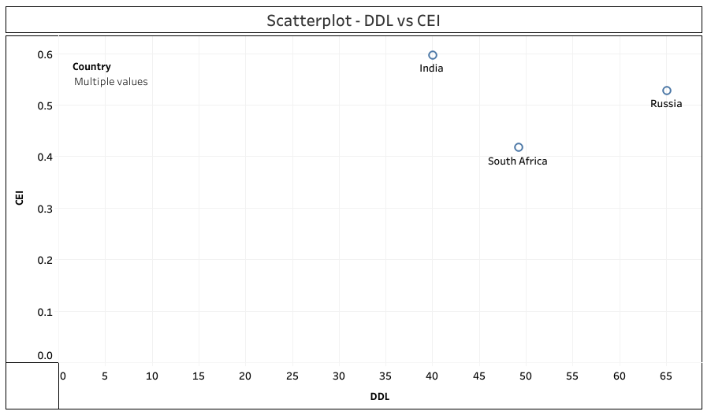

Slide 11
Key Cybersecurity Indices Comparison
Table: A comparative summary of key cybersecurity indices for selected countries, showing their scores in a structured format.
Insights:
Side-by-Side Comparison: The table facilitates a straightforward comparison of key cybersecurity indices (GCI, CEI, NSCI, DDL) across selected countries, making it easy to assess their performance.
Trend Identification: Viewers can quickly spot trends, strengths, and weaknesses in each country's cybersecurity effectiveness, helping to highlight best practices and areas for improvement.
Informed Discussions: This consolidated view serves as a valuable tool for discussions on international cybersecurity strategies, collaborations, and resource allocation among countries.

Slide 12
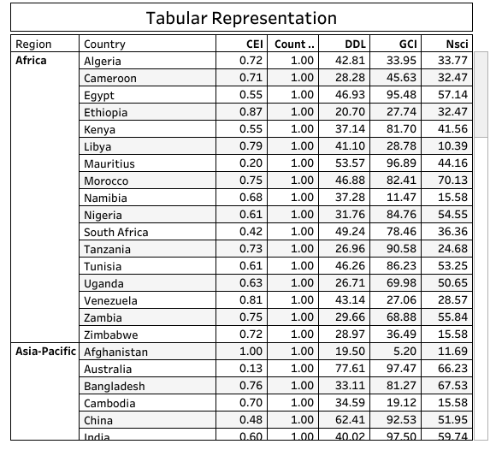

Slide 13
Conclusion
Summary of Findings:
The analysis highlights significant variations in cybersecurity effectiveness across countries, as indicated by the GCI, CEI, and NSCI scores.
Countries with higher Digital Development Levels (DDL) generally exhibit better cybersecurity effectiveness.
Regional trends reveal that some areas are significantly better prepared than others, suggesting targeted improvement opportunities for underperforming regions.
The findings underscore the importance of comprehensive cybersecurity strategies that consider both technical capabilities and overall digital maturity.

Slide 14
Future Work
Suggestions for Further Research:
Investigate additional factors that may influence cybersecurity effectiveness, such as economic stability, education levels, and international collaborations.
Analyze longitudinal data to observe trends in cybersecurity preparedness over time.
Explore the impact of emerging technologies, like artificial intelligence and machine learning, on enhancing cybersecurity measures.
Consider conducting case studies on countries that have significantly improved their cybersecurity indices to identify best practices.

